Slide 1


NLP-1: Fundamentals
The Text Preprocessing Pipeline
SOUMYADEV SAHA

Slide 2
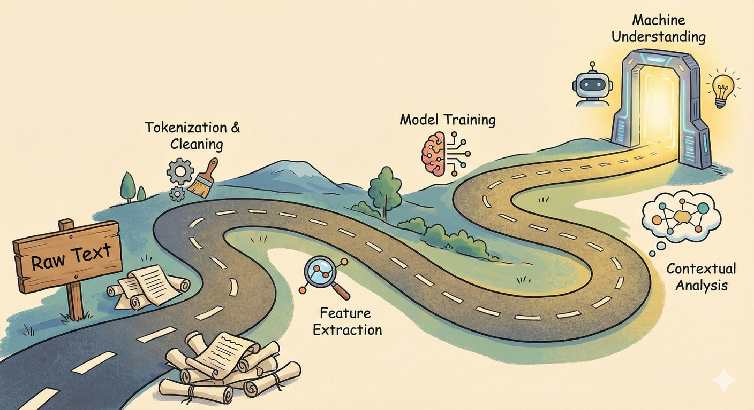
SRIB
PAGE 02
Today’s Roadmap: From Chaos to Structure
Defining the Field: What is NLP? The crucial difference between Understanding (NLU) and Generation (NLG).
Historical Context: How we moved from rigid grammar rules -> statistical probability -> modern Deep Learning.
The Core Bottleneck: Ambiguity. Why computers struggle with sarcasm, double meanings, and complex sentence structures.
The Data Fuel: Defining a "Corpus," data sourcing, and the importance of annotation.
The Preprocessing Pipeline (Hands-on logic): The step-by-step factory line of converting raw text into clean data: Cleaning, Tokenization, Stop Word Removal, and Normalization (Stemming vs. Lemmatization).

Slide 3
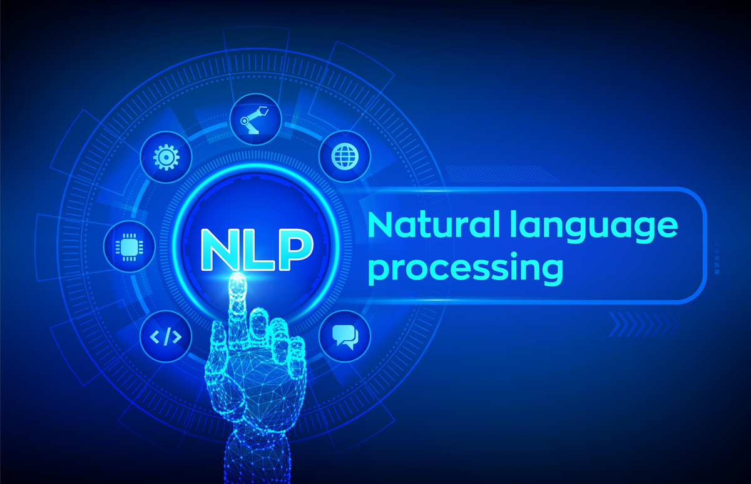
SRIB
PAGE 03
Natural Language Processing (NLP) Defined
Formal Definition: A branch of Artificial Intelligence concerned with giving computers the ability to understand text and spoken words in much the same way human beings can.
The Shift in Computing: Traditional computing deals with structured data (tables, spreadsheets, database numbers). NLP deals with unstructured data (emails, tweets, PDFs, medical records).
The Goal: To convert messy, unstructured human language into numerical representations that mathematical models can process to extract meaning, intent, or sentiment.

Slide 4
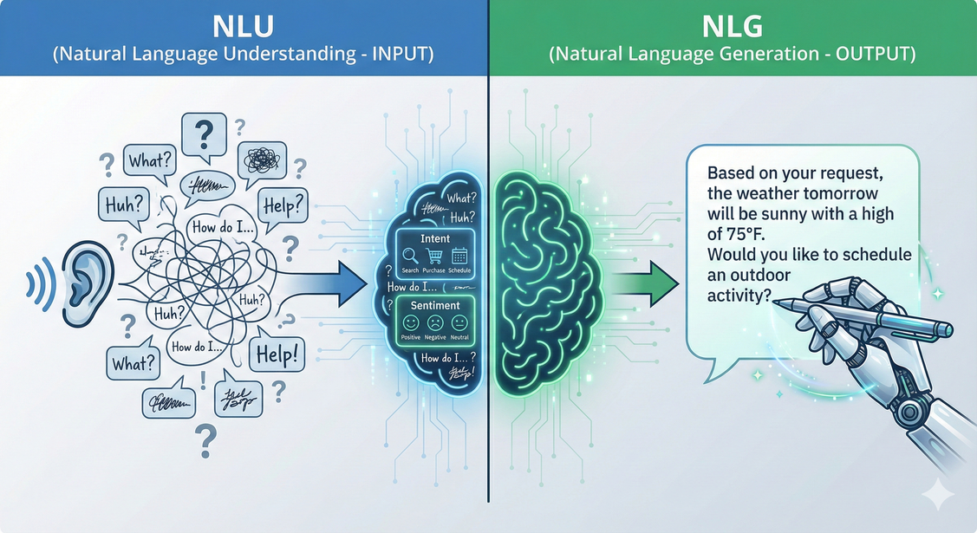
SRIB
PAGE 04
The Two Pillars: NLU vs. NLG
1. NLU (Natural Language Understanding) - The "Reader"
Focus: Comprehending the meaning and intent behind text. It’s about extracting structure from unstructured data.
Analogy: Like a human reading a book and summarizing the plot.
Examples: Sentiment Analysis (Is this review angry?), Spam Detection, Named Entity Recognition (Finding names/dates in contracts).
2. NLG (Natural Language Generation) - The "Writer"
Focus: Creating new, coherent human language from data or prompts.
Analogy: Like a human writing an essay based on a prompt.
Examples: ChatGPT responses, automated weather reports, language translation output, autocomplete.

Slide 5
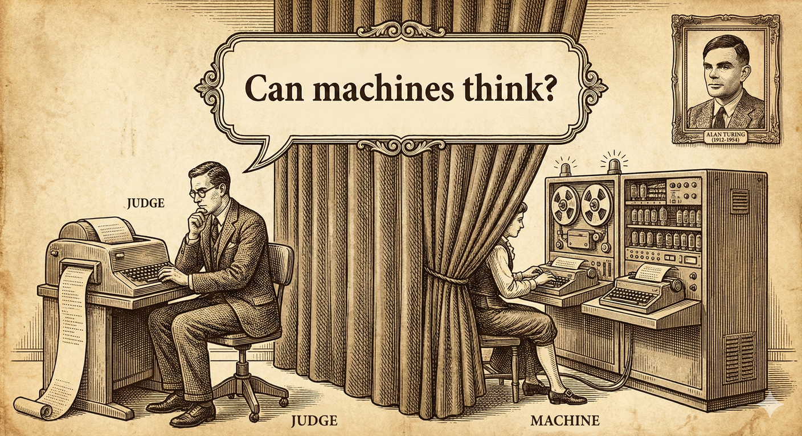
SRIB
PAGE 05
Contextualizing AI Progress (The Turing Test)
Alan Turing (1950): Proposed the "Imitation Game."
The Test: Can a machine converse with a human so naturally that the human cannot tell they are speaking to a machine?
Why it matters to NLP: For 60 years, this was science fiction. NLP is the core technology required to pass this test. With the advent of Large Language Models (LLMs) like GPT-4, many argue we are now passing this threshold daily. You are learning the technology that solved a 70-year-old challenge.

Slide 6
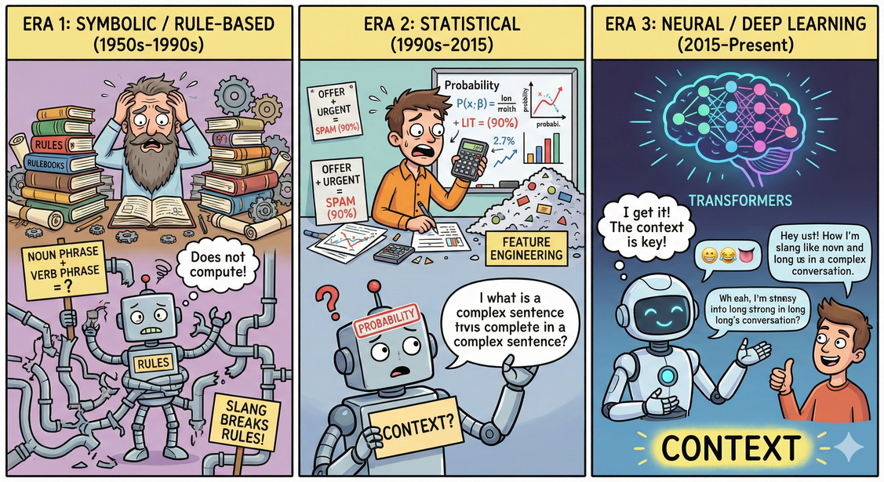
SRIB
PAGE 06
How We Got Here: The Evolution of Techniques
Era 1: Symbolic / Rule-Based (1950s-1990s)
Method: Linguists manually coded thousands of grammar rules (e.g., "A noun phrase followed by a verb phrase...").
Failure Mode: Language is fluid. Slang, typos, and complex sentence structures broke these rigid rules instantly. They couldn't scale.
Era 2: Statistical (1990s-2015)
Method: Using probability and machine learning (like Naive Bayes). "If the word 'offer' and 'urgent' appear together, there is a 90% chance it's spam."
Failure Mode: Required massive manual effort called "Feature Engineering" and struggled with long-term context.
Era 3: Neural / Deep Learning (2015-Present)
Method: Using massive multi-layered neural networks (Transformers) to learn context and meaning automatically from vast amounts of text data.

Slide 7
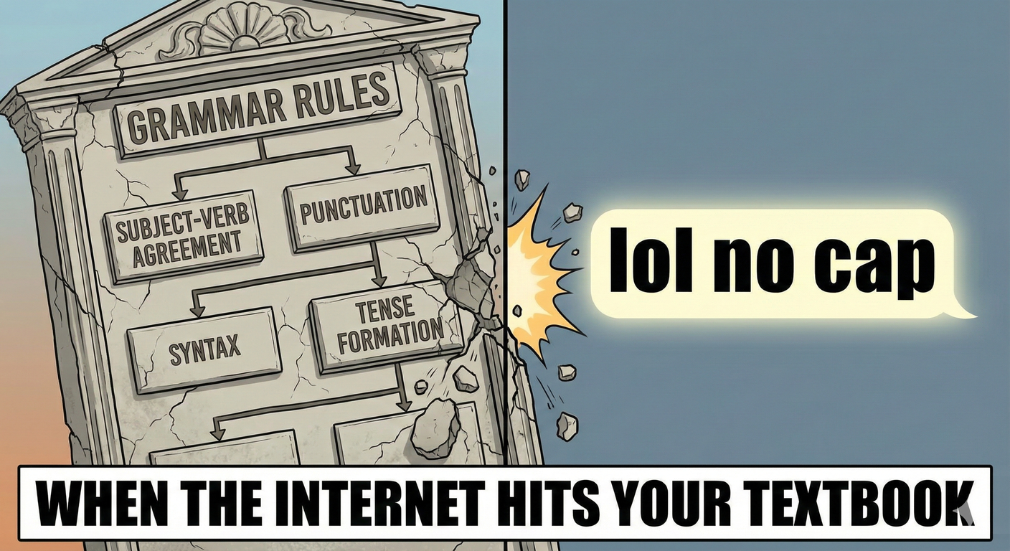
SRIB
PAGE 07
Why Rule-Based Systems Died
01
Humans do not speak in textbook grammar. We use slang, idioms, sarcasm, and abbreviations.
A rule-based system looking for "Subject + Verb" will crash on internet slang. Modern NLP must handle the messiness of real communication.

Slide 8
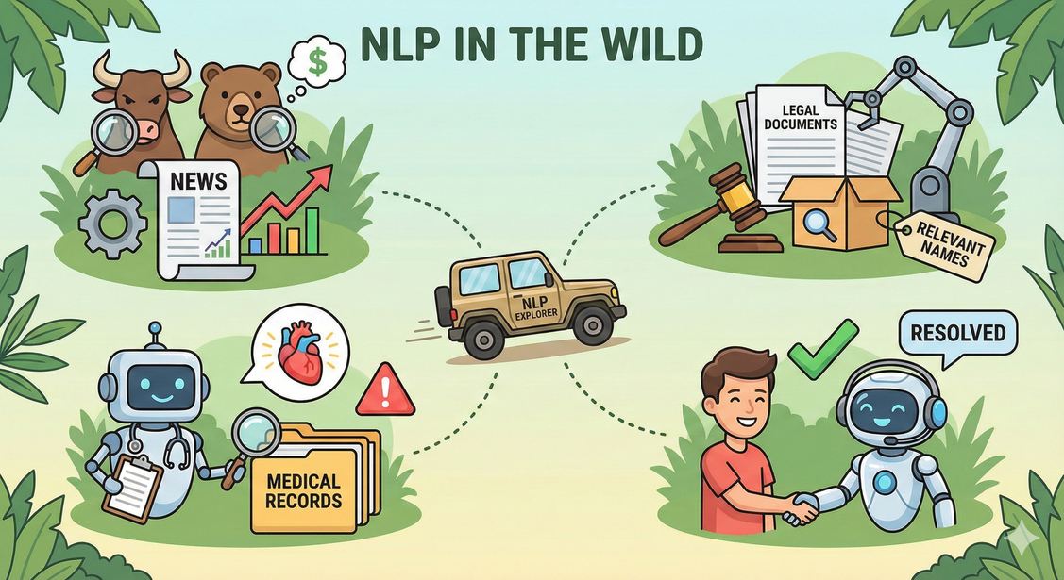
SRIB
PAGE 08
NLP in the Wild: Industry Use Cases
Finance: Analyzing earnings call transcripts and news headlines to predict stock market movements (Sentiment Analysis).
Healthcare: Scanning thousands of medical records to identify patients at risk for certain diseases by finding patterns in doctor's notes (Information Extraction).
Legal: E-discovery—scanning millions of documents in lawsuits to find relevant mentions of specific people or events (Named Entity Recognition).
Customer Service: Intelligent chatbots that can actually resolve issues rather than just providing links (Conversational AI).

Slide 9
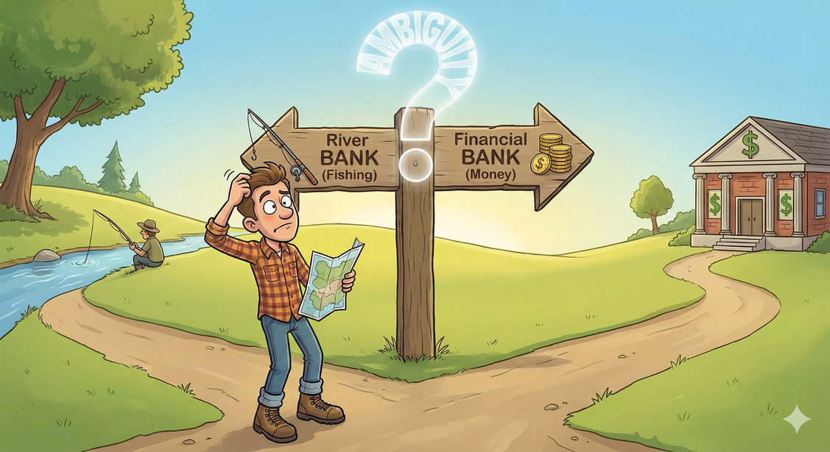
SRIB
PAGE 09
The Arch-Nemesis of NLP: Ambiguity
Computers thrive on precision (1s and 0s). Human language thrive on nuance and context. This mismatch is the core challenge.
Type 1: Lexical Ambiguity
When a single word has multiple distinct meanings.
Example: "The tank was full." (Are we talking about a military vehicle, a fish tank, or a gas tank? Without surrounding text, it's impossible to know).
We will be looking into other types of ambiguity in the following slides

Slide 10
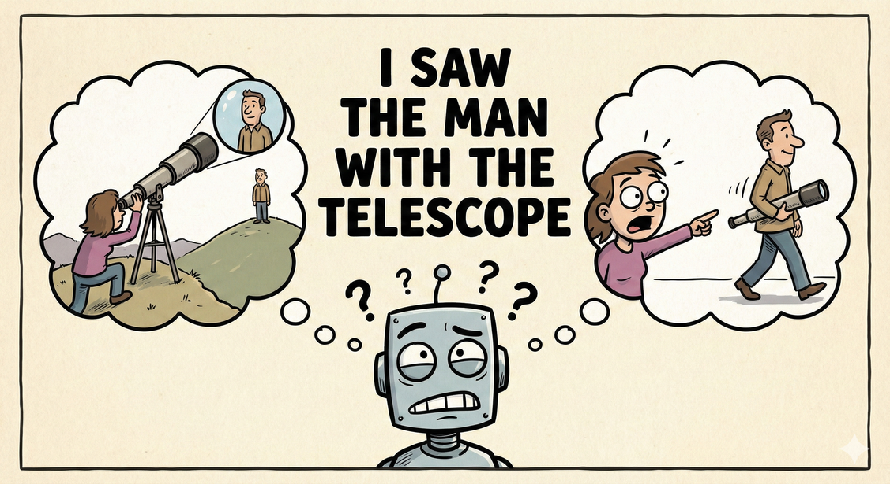
SRIB
PAGE 10
Ambiguity Type 2: Syntactic Ambiguity
(Structural Confusion)
When the structure of the sentence allows for multiple grammatical interpretations.
Classic Example: "I saw the man with the telescope."
Interpretation A: I used a telescope to see the man. (Telescope modifies "I saw").
Interpretation B: I saw a man who was holding a telescope. (Telescope modifies "the man").
For a computer to parse this correctly, it often needs world knowledge or prior context.

Slide 11
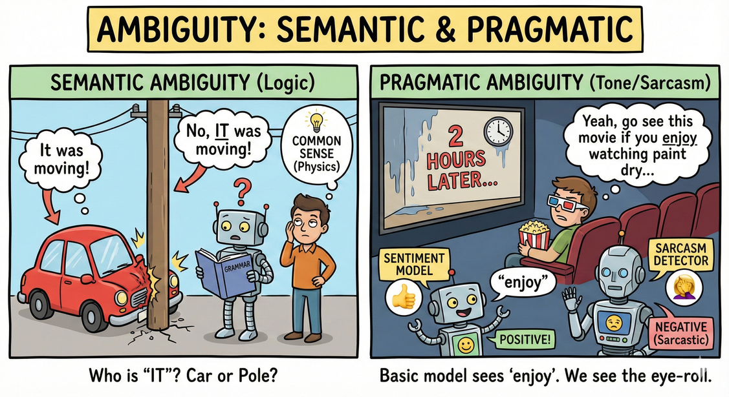
SRIB
PAGE 11
Ambiguity Types 3 & 4: Meaning and Tone
(Semantic & Pragmatic Ambiguity)
Semantic Ambiguity (Logic):
"The car hit the pole while it was moving."
Grammatically, "it" could refer to the car or the pole. Humans use common sense (physics) to know poles don't move. Computers lack this common sense unless explicitly trained on it.
Pragmatic Ambiguity (Tone/Sarcasm):
Example: A movie review that says, "Yeah, go see this movie if you enjoy watching paint dry for two hours."
A basic sentiment model sees the word "enjoy" and might classify it as positive. It completely misses the sarcastic intent. Sarcasm detection remains a major research area.

Slide 12
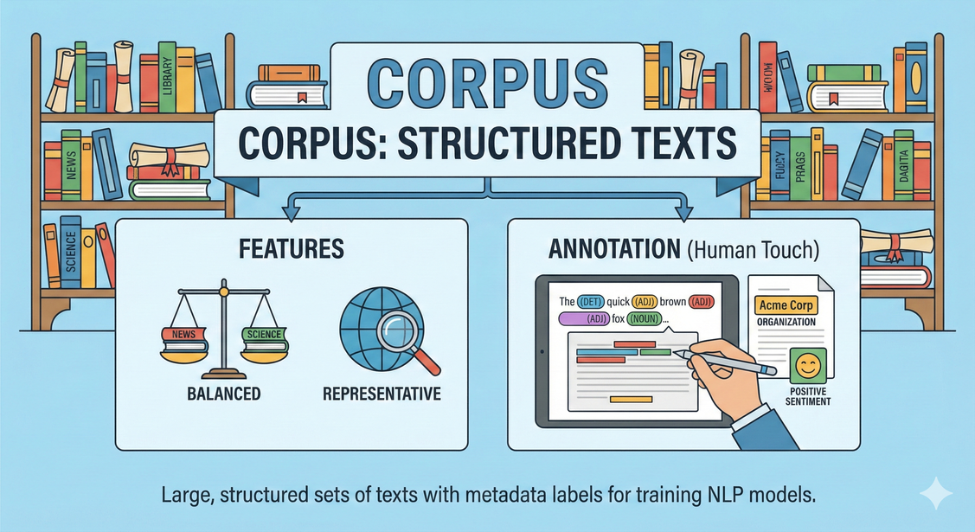
SRIB
PAGE 12
The Data Fuel: Corpora and Annotation
Corpus (Plural: Corpora): A large, structured set of texts used for training NLP models.
Features of a Good Corpus:
Balanced: Doesn't favor one topic or viewpoint excessively (unless intended).
Representative: Accurately reflects the real-world language it's meant to model (e.g., using medical journals for a medical bot, not Twitter).
Annotation (The Human Touch):
Raw text isn't enough for supervised learning. Humans must add metadata (labels).
Examples of Annotation: Tagging parts of speech (Noun, Verb), labeling sentiment (Positive/Negative), drawing bounding boxes around entities (Person, Organization). This is expensive but crucial data.

Slide 13
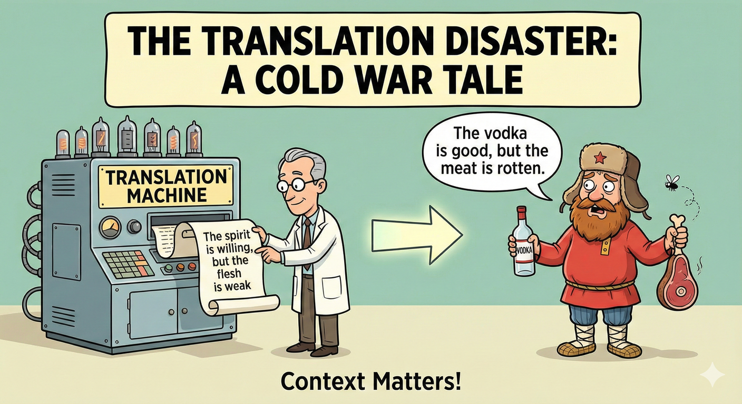
SRIB
PAGE 13
The Importance of Context (A Cold War Tale)
Early machine translation attempts relied on direct dictionary-to-dictionary word swaps.
The Experiment: Translating the biblical phrase "The spirit is willing, but the flesh is weak" from English into Russian, and back to English.
The Result: "The vodka is good, but the meat is rotten."
The Lesson: Language is not a cipher where one word equals another exact word in a different language. Meaning is derived from cultural and textual context.

Slide 14
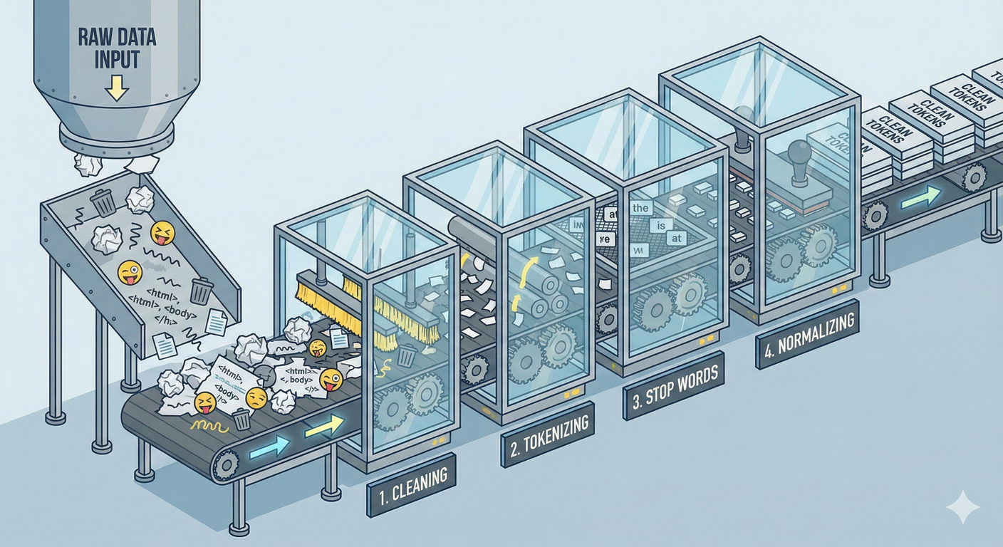
SRIB
PAGE 14
The NLP Pipeline: From Raw Text to Clean Data
Before we can do any AI or Math, we must clean the mess. This is 80% of an NLP engineer's job.
The Standard Steps:
Noise Removal/Cleaning: Getting rid of HTML, emojis, technical junk.
Tokenization: Chopping text into units.
Stop Word Removal: Removing low-information filler words.
Normalization: Standardizing words to their roots (Stemming/Lemmatization).
Goal: Reduce the complexity of the vocabulary while keeping the meaning.

Slide 15

SRIB
PAGE 15
The Janitor of NLP: Regular Expressions (Regex) [Step 1]
What is Regex? A powerful language for defining search patterns. Instead of searching for literal text, you search for types of text.
Why use it? Before tokenizing, you need to strip out non-language data.
Common Regex Patterns:
\d = Any digit (0-9)
\w = Any word character (letters, numbers, underscore)
\s = Whitespace (space, tab, newline)
. = Any character at all.
+ = One or more times. * = Zero or more times.

Slide 16
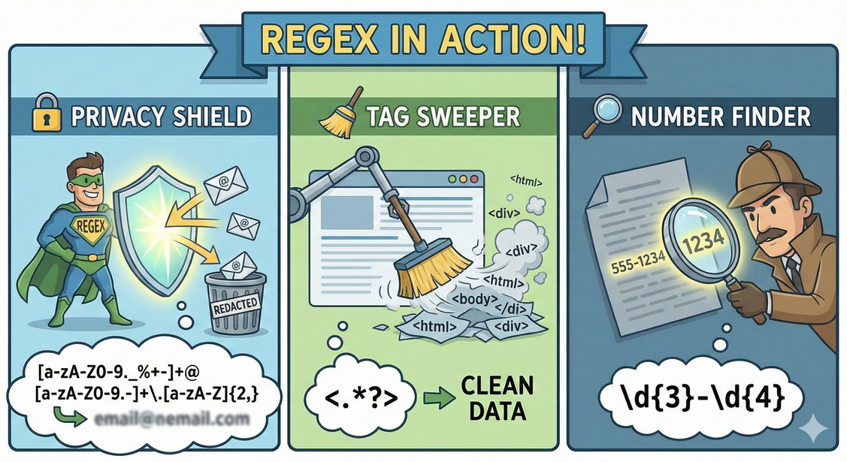
SRIB
PAGE 16
Regex Examples in Action
Goal: Remove email addresses for privacy.
Pattern: [a-zA-Z0-9._%+-]+@[a-zA-Z0-9.-]+\.[a-zA-Z]{2,}
Explanation: Looks for characters, then an "@" symbol, then domain name characters, then a dot, then a 2+ letter extension like ".com".
Goal: Remove HTML tags from web scraped data.
Pattern: <.*?>
Explanation: Find a opening bracket <, match any character . until you hit the first closing bracket >.
Goal: Find phone numbers formatted like 555-1234.
Pattern: \d{3}-\d{4}

Slide 17
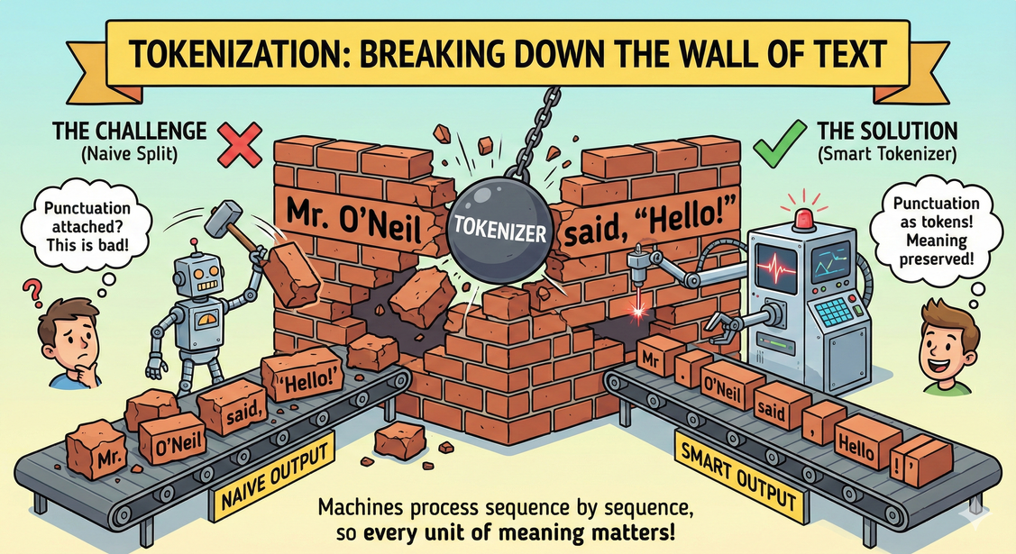
SRIB
PAGE 17
Tokenization: Breaking Down the Wall of Text [Step 2]
Definition: The process of segmenting text into smaller units called "tokens".
Why? Machines cannot process a whole paragraph at once. They process sequence by sequence.
The Challenge of Punctuation:
Input: "Mr. O'Neil said, 'Hello!'"
A naive split by space gives: ["Mr.", "O'Neil", "said,", "'Hello!'"] -> Notice the attached punctuation marks. This is bad.
A smart tokenizer gives: ["Mr.", "O'Neil", "said", ",", "'", "Hello", "!", "'"] -> Punctuation marks become their own tokens because they carry meaning (e.g., emphasis, pauses, end of thought).

Slide 18
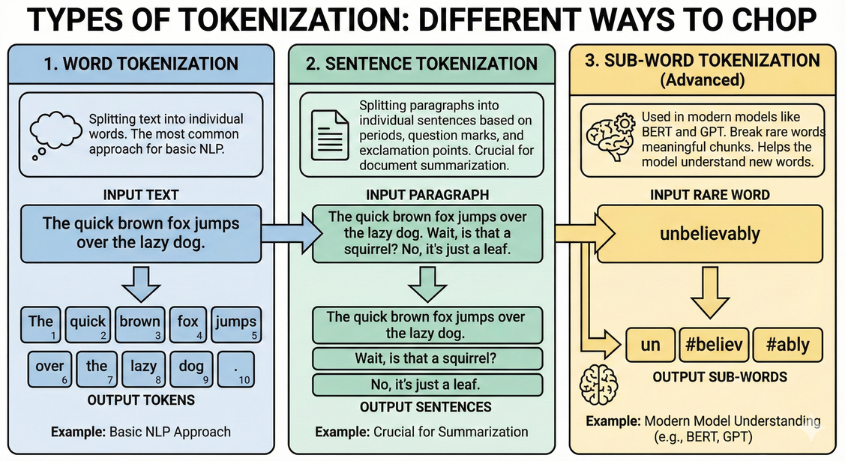
SRIB
PAGE 18
Different Ways to Chop - Types of Tokenization
1. Word Tokenization: Splitting text into individual words. The most common approach for basic NLP.
2. Sentence Tokenization: Splitting paragraphs into individual sentences based on periods, question marks, and exclamation points. Crucial for tasks like document summarization.
3. Sub-word Tokenization (Advanced): Used in modern models like BERT and GPT.
Idea: Break rare words into meaningful chunks.
Example: "unbelievably" -> ["un", "#believ", "#ably"].
Benefit: Helps the model understand the components of new words it hasn't seen before by recognizing prefixes and suffixes.

Slide 19
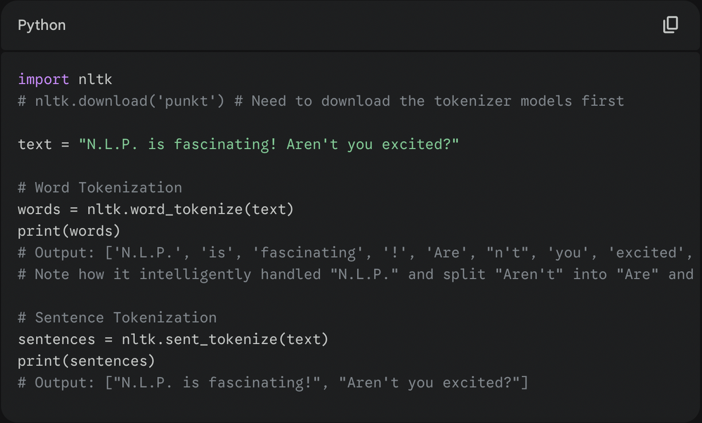

SRIB
PAGE 19
Hands-on: Tokenization in Python with NLTK
We use libraries like NLTK (Natural Language Toolkit) or SpaCy to do this efficiently.

Slide 20
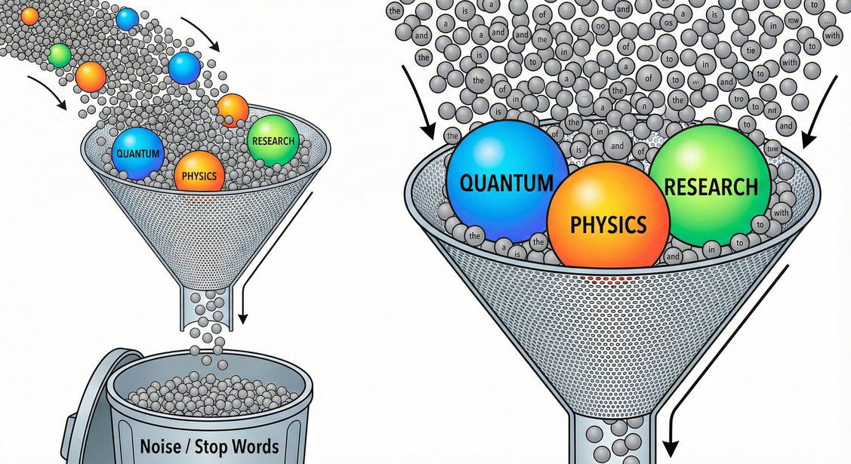
SRIB
PAGE 20
Stop Words: Filtering out the Noise [Step 3]
Definition: High-frequency words that carry very little unique semantic meaning in a specific context.
Examples (English): "the", "is", "at", "which", "on", "a", "an", "and".
The Logic (Zipf's Law): In any language, a tiny number of words make up a massive percentage of all text used. The word "the" accounts for roughly 7% of all English speech.
Why remove them?
Efficiency: Reduces the size of the dataset significantly, making training faster.
Focus: Allows statistical models to focus on the rare, meaningful keywords (e.g., in a document about "Quantum Physics," the word "Quantum" is important; "the" is not).

Slide 21
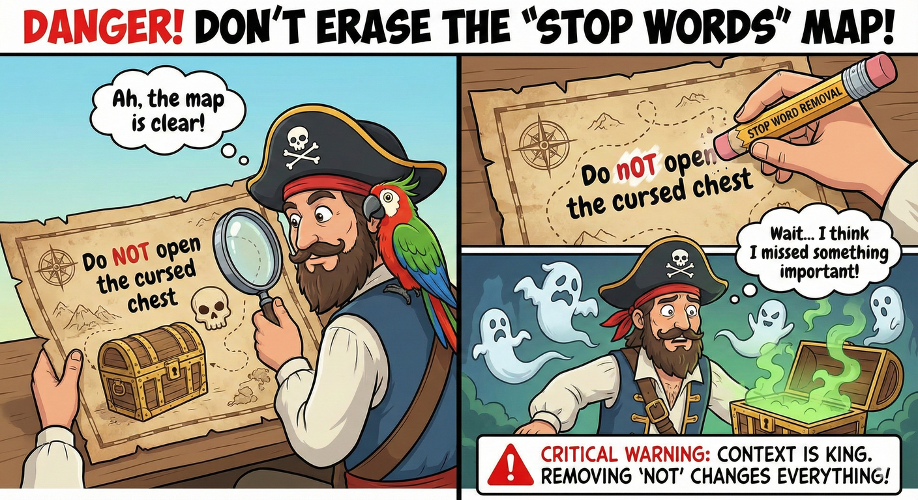
SRIB
PAGE 21
When NOT to Remove Stop Words
Context is King. Stop word removal is not a universal rule.
Case Study 1: Sentiment Analysis
Sentence: "The movie was not good."
If "not" is in your stop word list and you remove it: "The movie was good."
Result: You just completely flipped the sentiment from negative to positive. Disaster.
Case Study 2: Specific Phrases
Phrase: "To be or not to be."
After stop word removal: [empty string].
Rule of Thumb: Remove them for search engines or topic modeling. Keep them for sophisticated tasks involving nuanced meaning or sentiment.

Slide 22
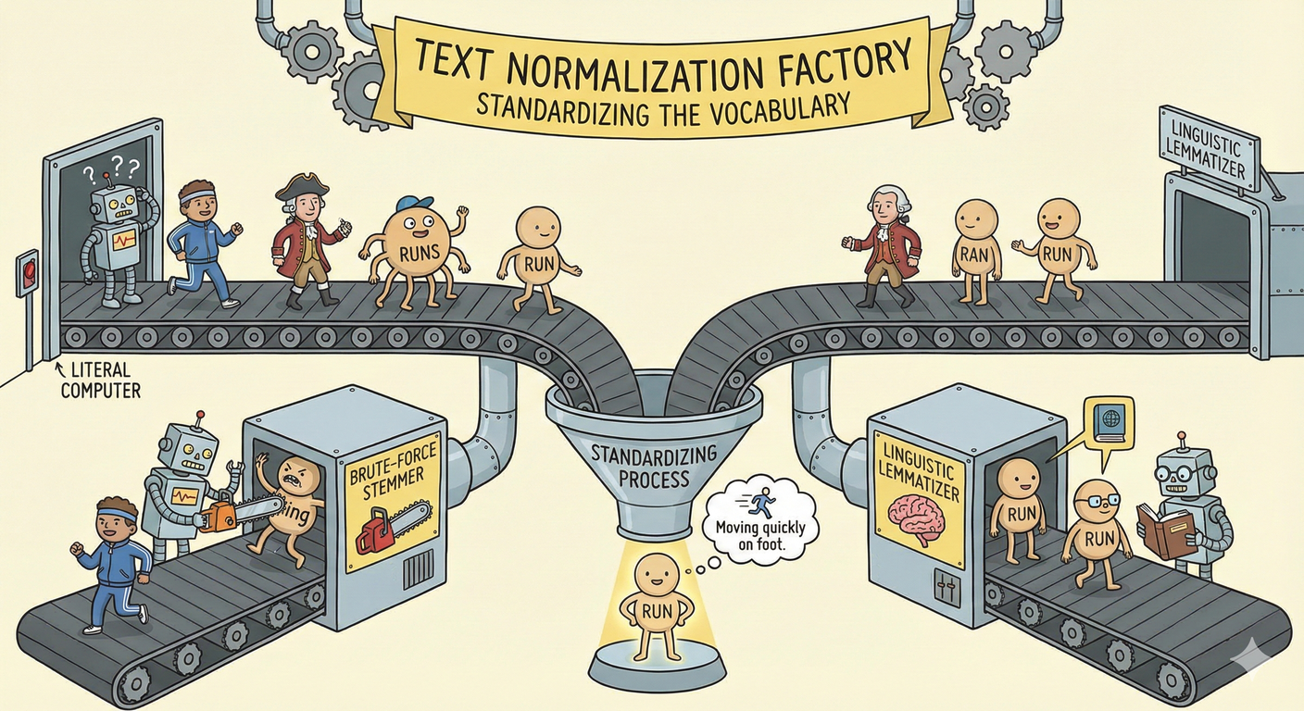
SRIB
PAGE 22
Text Normalization: Standardizing the Vocabulary [Step 4]
The Problem: Computers are literal. To a computer, these are four completely distinct strings:
"run"
"running"
"ran"
"runs"
The Goal: We want the machine to understand that these all represent the same base concept of "moving quickly on foot."
The Solution: Convert variations of a word into a single, standardized form.
The Two Methods: Stemming (The brute-force method) vs. Lemmatization (The linguistic method).

Slide 23
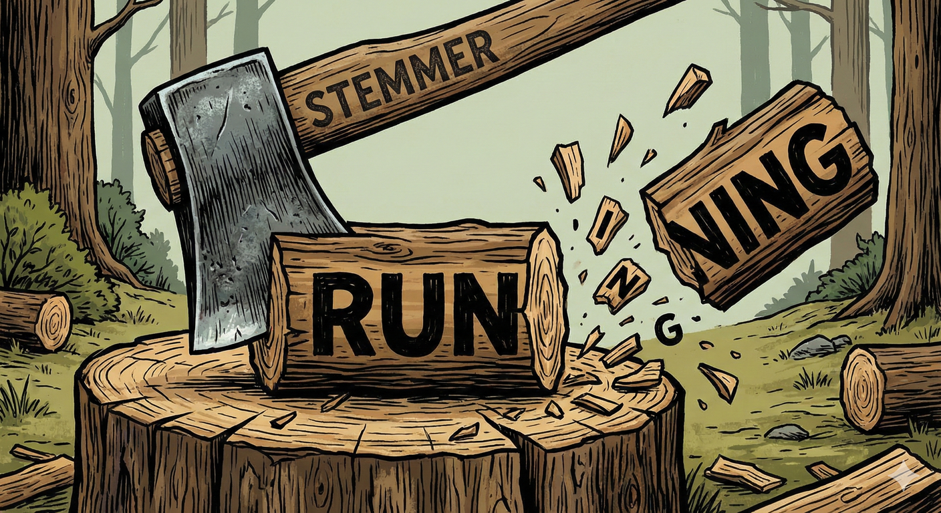
SRIB
PAGE 23
Method 1 : Stemming - The Heuristic Approach
How it works: A crude, rule-based process that chops off the ends of words (suffixes) in the hope of achieving the goal correctly most of the time. It does NOT use a dictionary.
Popular Algorithm: The Porter Stemmer.
Examples:
"Working" -> "Work" (Success)
"Cats" -> "Cat" (Success)
"Universities" -> "Univers" (Fail - "Univers" is not a real word).
Pros: Very fast computationally.
Cons: Often produces non-words; can be overly aggressive (over-stemming).

Slide 24
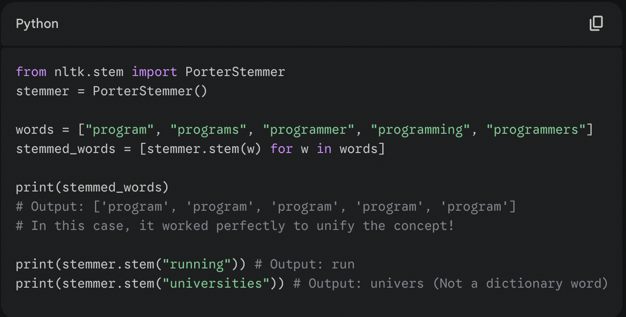
SRIB
PAGE 24
Hands-on: Stemming Code Example (NLTK)
Observe how it handles different variations, sometimes producing fragments.

Slide 25
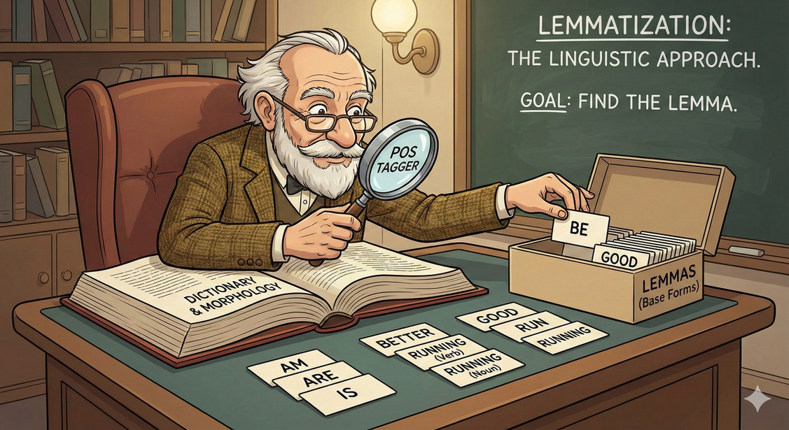
SRIB
PAGE 25
Method 2 : Lemmatization - The Linguistic Approach
How it works: An organized, principled approach that uses a vocabulary and morphological analysis of words. It aims to return the Lemma—the base or dictionary form of a word.
Crucial Requirement: Part of Speech (POS) Tagging. To lemmatize correctly, the model needs to know if the word is used as a noun, verb, or adjective.
Examples:
"Am", "Are", "Is" -> Lemma: "Be" (Stemming cannot do this).
"Better" -> Lemma: "Good" (Stemming would just return "Better").
"Running" (Verb) -> "Run". "Running" (Noun, as in "The running of the bulls") -> "Running".

Slide 26
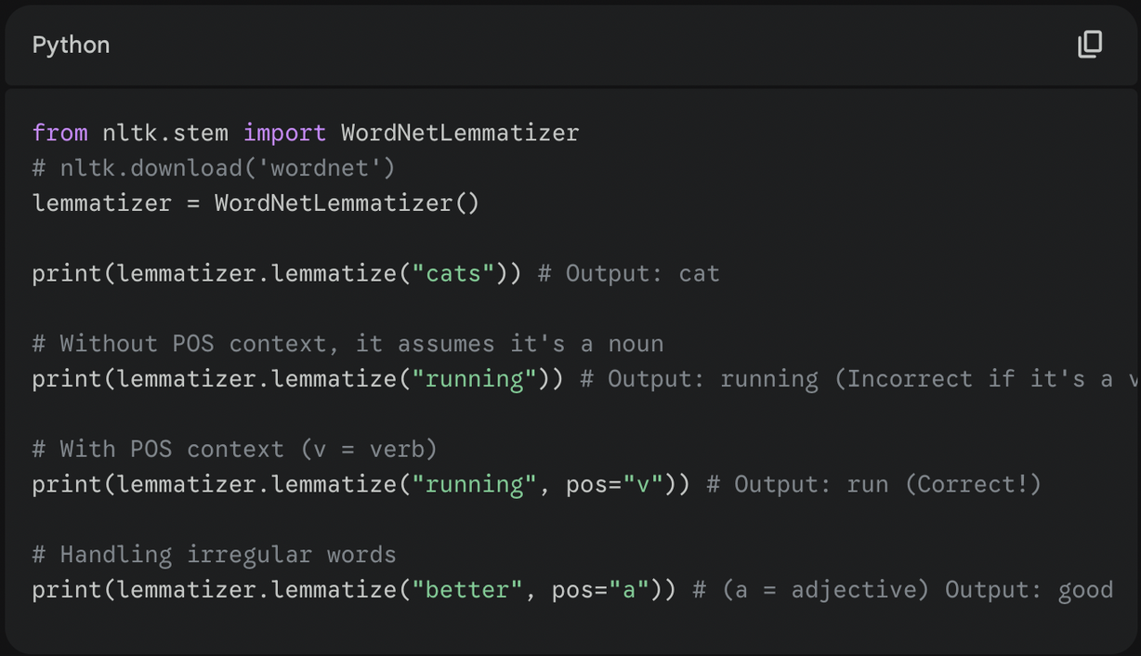
SRIB
PAGE 26
Hands-on: Lemmatization Code Example (NLTK)
Notice the importance of telling the lemmatizer the "Part of Speech" (pos parameter).

Slide 27
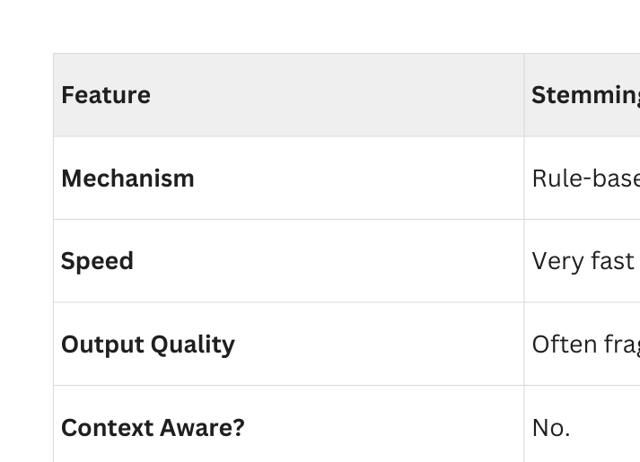
SRIB
PAGE 27
The Final Showdown: Stemming vs. Lemmatization

Slide 28
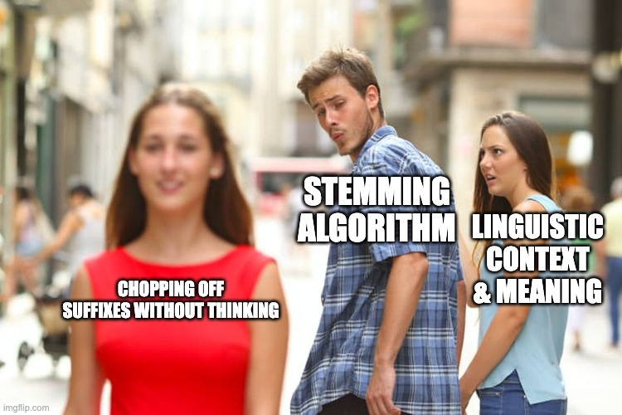
SRIB
PAGE 28
Stemming Gone wrong : When lack of context fails...
If you input the sentence "I am flying to New York", a stemmer might reduce "flying" to "fly".
The computer now thinks you are an insect (a fly), rather than a human performing the action of flying. Lemmatization prevents this error by understanding the verb context.

Slide 29
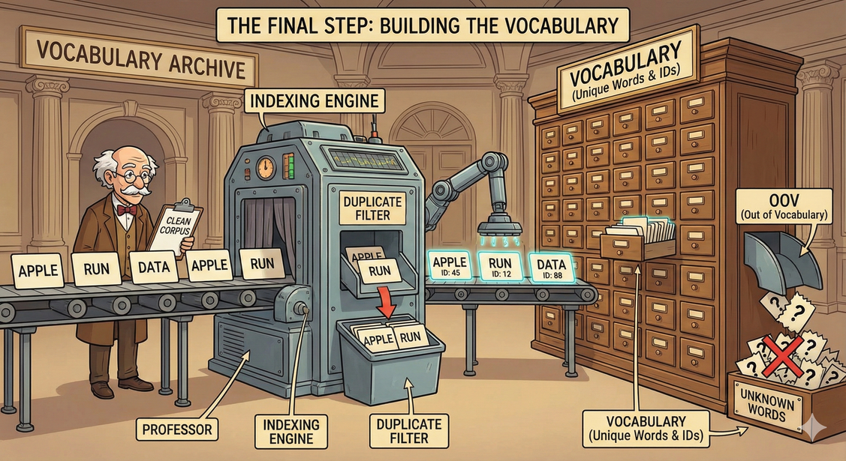
SRIB
PAGE 29
Output of Preprocessing: The Vocabulary [Final Step]
Once the text is cleaned, tokenized, normalized, and stop words removed, you are left with a list of clean tokens.
Vocabulary (Vocab): The set of all unique words remaining in your entire corpus.
Indexing: This is the bridge to Day 2. We assign a unique integer ID to every word in the vocabulary.
"apple" -> ID: 45
"run" -> ID: 12
"data" -> ID: 88
The OOV Problem: Words that appear in real-world use but were not in your training vocabulary are called "Out of Vocabulary" (OOV) words. Handling them is a major challenge in NLP.

Slide 30
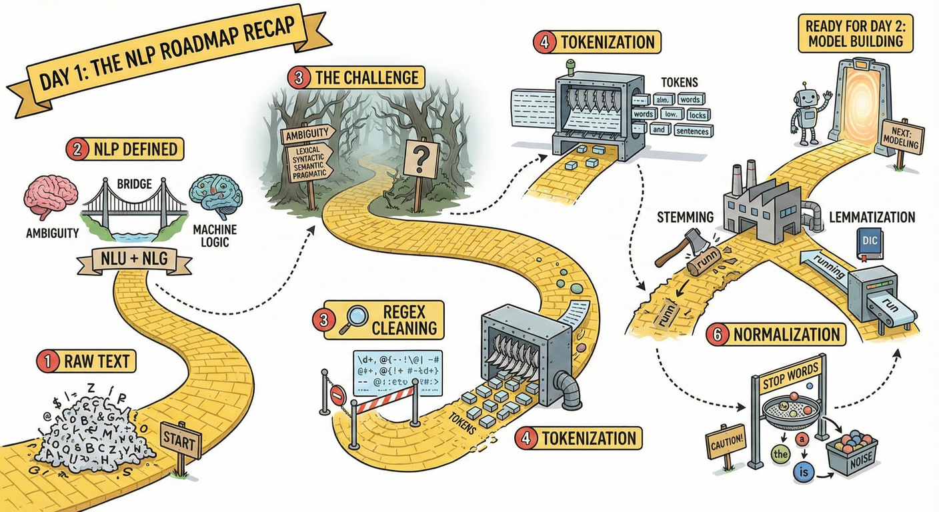
SRIB
PAGE 30
Let's review what we covered today.
NLP Defined: The bridge between human ambiguity and machine logic. NLU (Understanding) + NLG (Generation).
The Challenge: Ambiguity (Lexical, Syntactic, Semantic, Pragmatic) is why this field is difficult.
The Pipeline: Raw text is useless. We must clean it.
Regex: For pattern-based cleaning.
Tokenization: Splitting text into meaningful units (words/sentences).
Stop Words: Removing high-frequency noise (with caution!).
Normalization: Reducing word variations using Stemming (fast/crude) or Lemmatization (slow/accurate).

Slide 31
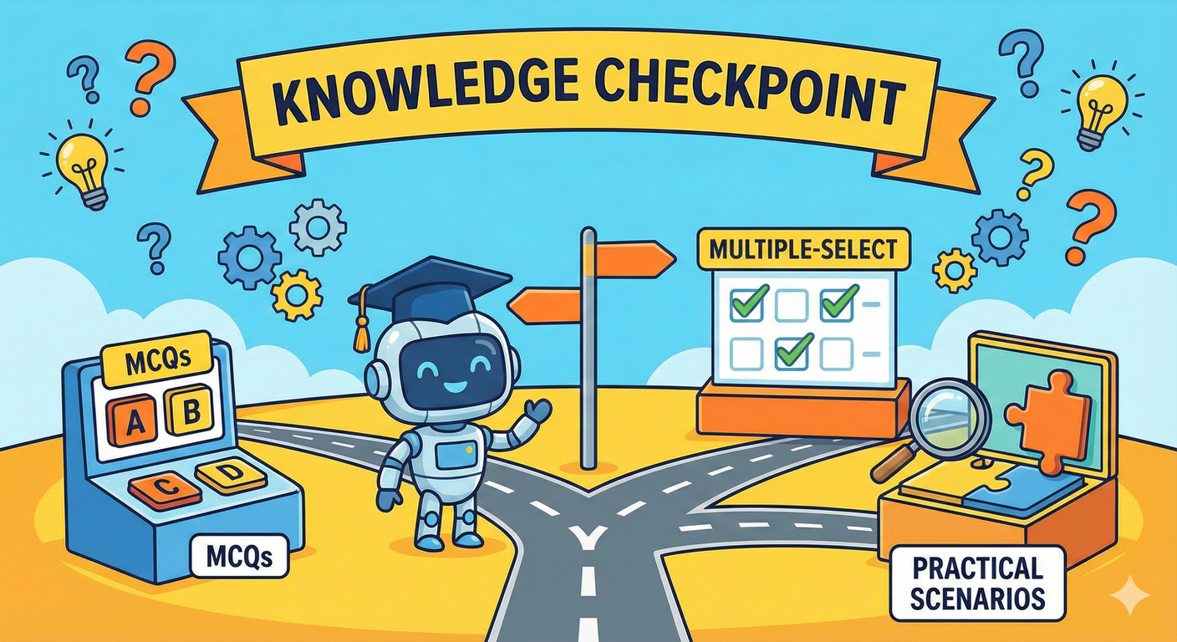
SRIB
PAGE 31
Knowledge Checkpoint
Let's test our understanding of the core concepts. Get ready for MCQs, multiple-select questions, and practical scenarios.

Slide 32

SRIB
PAGE 32
Question 1 (Ambiguity Types)
Question: Consider the sentence: "The bat flew out of the cave." Which type of ambiguity exists in this sentence, if any?
A) Syntactic Ambiguity
B) Lexical Ambiguity
C) Pragmatic Ambiguity
D) No Ambiguity
(Answer on next slide)

Slide 33
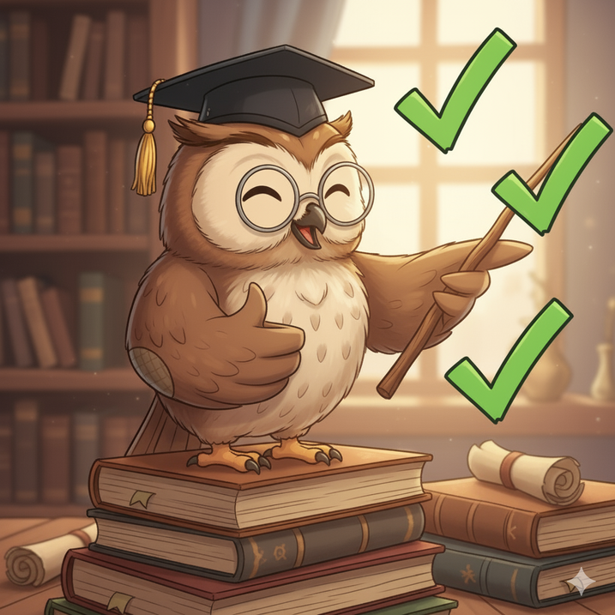
SRIB
PAGE 33
Answer: B) Lexical Ambiguity
Why B is correct: The word "bat" has multiple definitions. It could be a flying mammal, or it could be a wooden club used in baseball. The word itself is ambiguous.
Why others are wrong:
A) Syntactic ambiguity relates to sentence structure (like the "telescope" example). The structure here is clear: Subject-Verb-Prepositional Phrase.
C) Pragmatic ambiguity relates to tone or sarcasm, which isn't present here.

Slide 34
SRIB
PAGE 34
Question 2 (Tokenization Logic)
Question: You are using a standard Word Tokenizer (like NLTK's default) on the following string: "Wow! That's incredibly cool." How many tokens will be generated?
A) 4
B) 5
C) 6
D) 8
(Answer on next slide)

Slide 35
SRIB
PAGE 35
Answer: C) 6 Tokens
A good tokenizer separates punctuation marks because they carry meaning. It also handles contractions smartly.
The tokens would likely be:
"Wow"
"!" (Punctuation is its own token)
"That"
"'s" (Contraction split: 'That is')
"incredibly"
"cool." (Sometimes the final period is separate, sometimes attached depending on the specific tokenizer, but NLTK default usually splits final punctuation too, making it 7: cool, .. Let's assume 6 or 7 depending on the exact implementation, but 4 or 5 are definitely wrong as they ignore punctuation splitting). Self-correction: NLTK default word_tokenize would output: ['Wow', '!', 'That', "'s", 'incredibly', 'cool', '.'] which is 7 tokens).

Slide 36
SRIB
PAGE 36
Question 3 (Stemming vs Lemmatization)
Question: Select ALL statements that accurately describe the difference between Stemming and Lemmatization.
A) Stemming always results in a valid dictionary word.
B) Lemmatization requires Part-of-Speech (POS) tags to be fully accurate.
C) Stemming is generally computationally faster than lemmatization.
D) Lemmatization would convert the word "Better" into "Good".
(Answer on next slide)

Slide 37
SRIB
PAGE 37
Answer: B, C, and D are Correct.
A is False: Stemming often produces fragments like "univers" or "runn".
B is True: To know if "running" should become "run" (verb) or stay "running" (noun), the lemmatizer needs the POS tag.
C is True: Stemming is simple rule-based string chopping; Lemmatization involves complex dictionary lookups.
D is True: Lemmatization understands irregular grammatical forms; Stemming does not.

Slide 38
SRIB
PAGE 38
Question 4 (Regex Practical)
Question: You have the text: "Order ID: AB-991, AB-882, and BC-101." You apply the Regex pattern: [A-Z]{2}-\d+ Which of the following will be matched?
A) Only "AB-991"
B) "AB", "BC"
C) "991", "882", "101"
D) "AB-991", "AB-882", "BC-101"
(Answer on next slide)

Slide 39
SRIB
PAGE 39
Answer: D) All three IDs.
Let's break down the pattern [A-Z]{2}-\d+:
[A-Z]{2}: Matches exactly two uppercase letters consecutively (e.g., AB, BC).
-: Matches a literal hyphen character.
\d+: Matches one or more digits (e.g., 991, 882, 101).
Since all three order IDs in the text fit this exact structure, all three will be found by the regex engine.

Slide 40
SRIB
PAGE 40
Question 5 (Stop Words Scenario)
Question: You are building an NLP model to automatically detect negation in legal contracts (e.g., finding clauses that say "shall not be liable"). Should you remove standard stop words during preprocessing?
A) Yes, to make the model run faster.
B) No, because words like "not", "nor", or "neither" are critical for changing the meaning of legal clauses.
C) Yes, because legal documents are long and need compression.
(Answer on next slide)

Slide 41
SRIB
PAGE 41
Answer: B) No.
In legal, medical, and sentiment analysis contexts, small words often hold massive significance.
Removing "not" from a contract clause flips its entire legal meaning.
While efficiency (A and C) is important, accuracy is paramount in legal NLP. You would likely use a customized stop word list that keeps negation words, or forgo stop word removal entirely.

Slide 42
SRIB
PAGE 42
Question 6 (Corpus Concepts)
Question: A large collection of text used for training NLP models is called a ______. When humans add labels to this text (like marking sentiments or entities), the process is called ______.
(Answer on next slide)

Slide 43
SRIB
PAGE 43
Answer: Corpus; Annotation
Corpus: The raw fuel. The collection of documents.
Annotation: The process of adding intelligence to that fuel by labeling it, which is necessary for supervised machine learning models to learn patterns.

Slide 44
SRIB
PAGE 44
Question 7 (Numerical Logic - Zipf's Law)
Question: (Concept Check) Why does removing just the top 10-20 most frequent stop words from a large English corpus often reduce the total token count by 25-30%?
(Answer on next slide)

Slide 45
SRIB
PAGE 45
Answer: Zipf's Law
Language follows a power-law distribution known as Zipf's Law.
It states that the frequency of a word is inversely proportional to its rank in the frequency table.
The 1st most common word ("the") occurs twice as often as the 2nd most common word, and three times as often as the 3rd, etc.
Because the top few words are used so incredibly frequently, removing just a handful of them eliminates a massive chunk of the total word count in the corpus.

Slide 46
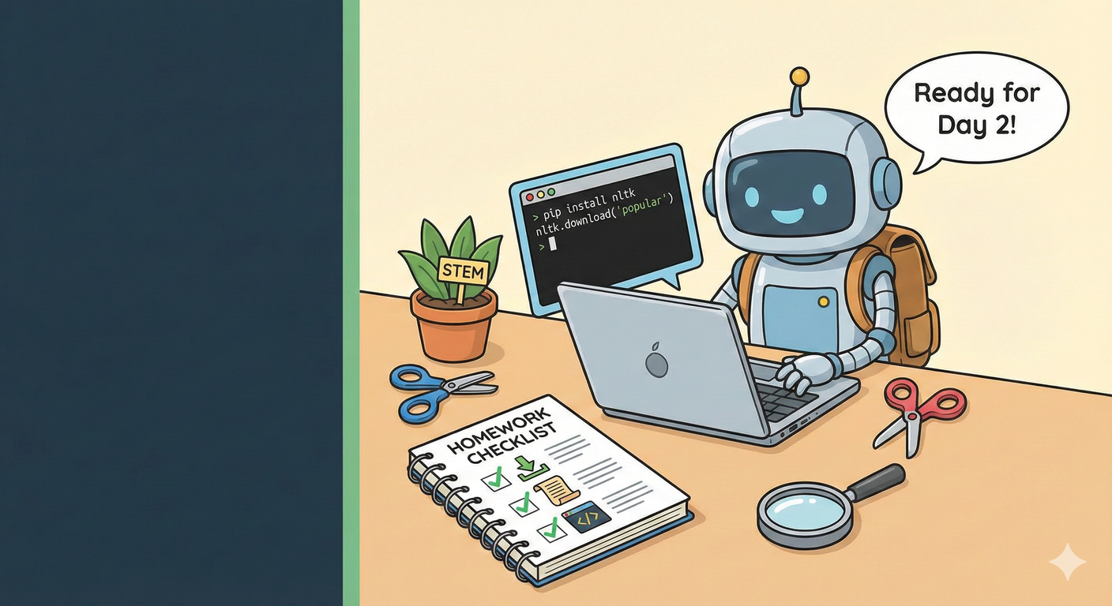
SRIB
PAGE 46
Hands-on Practise on Day 1 Concepts
Task 1 (Setup): Install Python and the NLTK library (pip install nltk). Run nltk.download('popular') in a Python script to get the necessary data.
Task 2 (Hands-on): Find a paragraph of text (a news article intro, your LinkedIn bio).
Task 3 (Apply): Write a Python script to:
Sentence tokenize it.
Word tokenize the first sentence.
Apply a Porter Stemmer to those words and print the result.

Slide 47
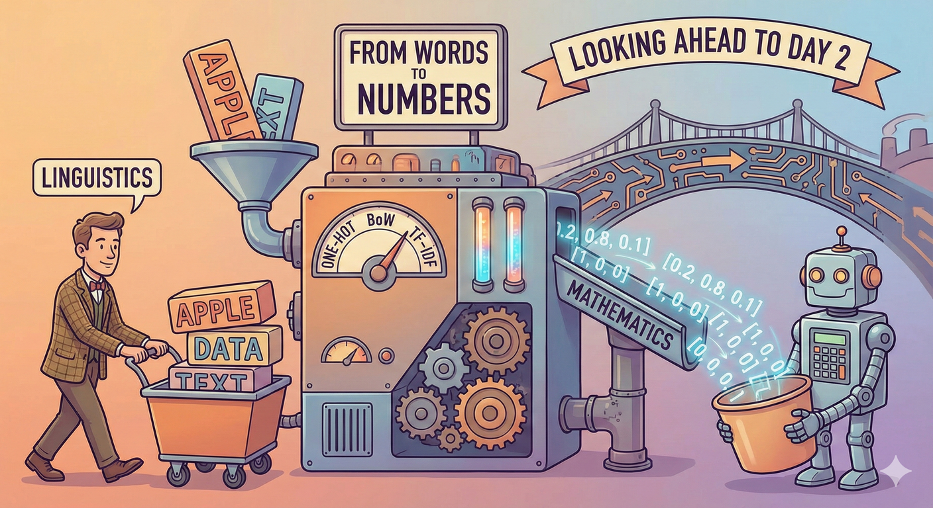
SRIB
PAGE 47
Next Class: From Words to Numbers
Today, we cleaned the text and made a vocabulary list.
Tomorrow, we cross the bridge from Linguistics to Mathematics.
How do we turn the word "Apple" into a vector like [0.2, 0.8, 0.1] ?
We will cover: One-Hot Encoding, Bag-of-Words (BoW), and TF-IDF.

Slide 48
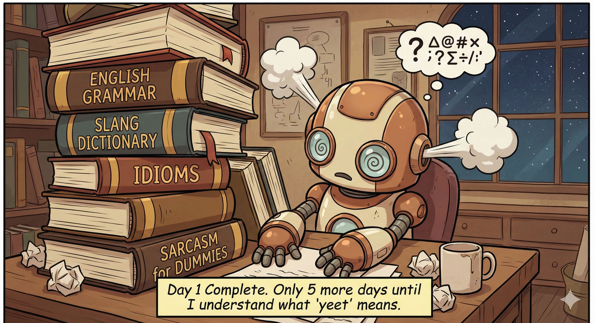
SRIB
PAGE 48
Completion of Day 1
"Day 1 complete. Only 5 more days until we understand what NLP means."

Slide 49
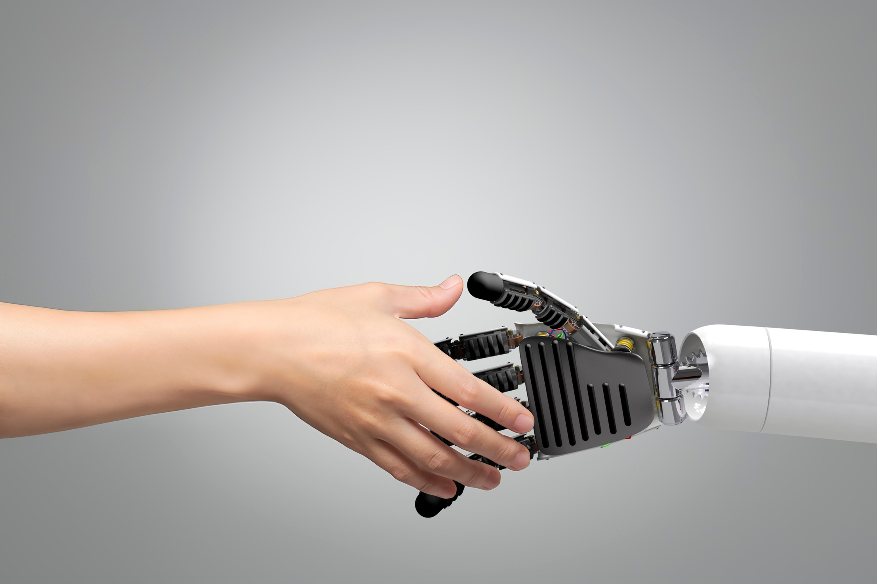
SRIB
PAGE 49
THANK YOU
Q&A

